Slide 1

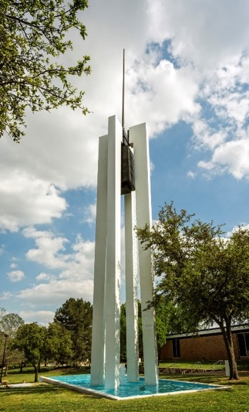
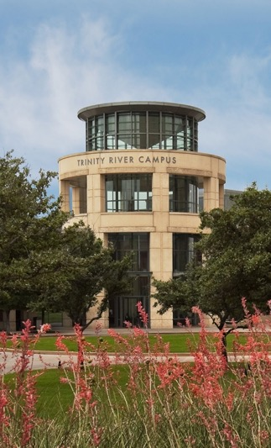
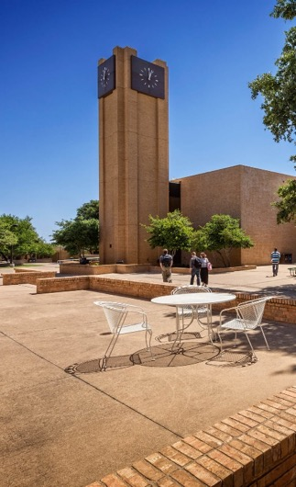
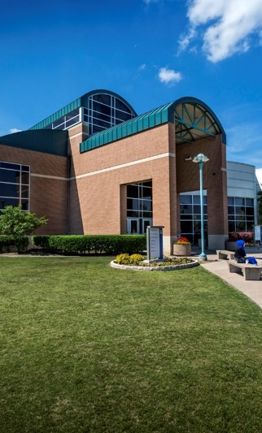
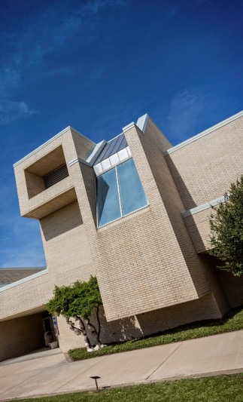
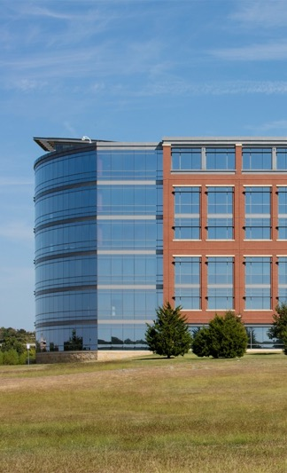
Do You Git It Now? Version Control & Collaboration with Git & GitHub
OFFICE OF INSTITUTIONAL RESEARCH
August 2020
Office of Institutional Research

Slide 2
Do You Git It Now? Version Control & Collaboration with Git & GitHub
OFFICE OF INSTITUTIONAL RESEARCH
August 2020
Office of Institutional Research

Slide 3
What is Version Control?
Version Control Systems (VCS) help manage changes to files
Database of all changes: who, what, when, and why
Office of Institutional Research

Slide 4
Why use version control?
Help you manage files and projects
Only one version of a file
Office of Institutional Research

Slide 5
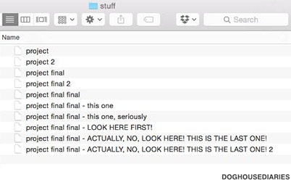

Slide 6
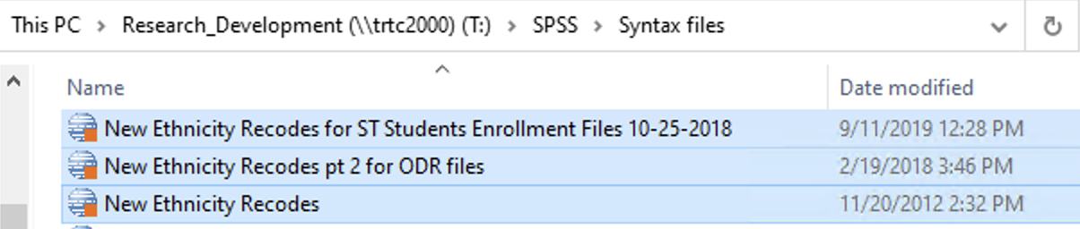
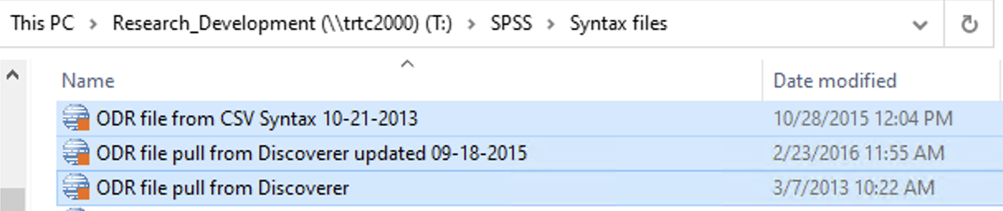

Slide 7
Why use version control?
Help you manage files and projects
Only one version of a file
Undo changes even after saving and closing
All changes are:
Tracked
Linked to the person who made them
Traceable and reversible
Can sync to a cloud service (e.g., GitHub)
Office of Institutional Research

Slide 8
Why use version control?
Help you collaborate
Don’t have to wait for a green light
Work on the same file at the same time
Spot and resolve conflicts
No emailing files back and forth, manually tracking versions
Office of Institutional Research

Slide 9

One of many VCS options
Popular
Robust
Well-documented
Community support
Distributed VCS
Easy integration with GitHub
Office of Institutional Research

Slide 10



Slide 11
GitHub
Free website
Store code, documents, even some data
More than just cloud storage
Office of Institutional Research

Slide 12
GitHub
Launched 2007
Used by >50 million people, host >100 million project repositories
Major companies: Airbnb, Facebook, Netflix, reddit, Lyft
Major projects:
Linux operating system, Facebook’s react JavaScript library, TensorFlow machine learning framework, Microsoft’s Visual Studio, Window’s Terminal, and more
Fun fact: Git was created by the founder of Linux, Linus Torvalds, in 2005 to help manage the development of the Linux kernel
Sources:
github.com/about
stackshare.io/github
Office of Institutional Research

Slide 13
GitHub: Major Features
Pull requests: allow you to collaborate with other projects/repos
Issue tracking:
Mostly for long-term projects
Users (or others) can submit problems, suggestions
Owners can organize, track issues
Wikis: documentation, usage guides
Office of Institutional Research

Slide 14



GitHub: Pull requests
GH repo
Fork the repo
Make edits
Pull request
Office of Institutional Research

Slide 15
Git-ting started
Office of Institutional Research

Slide 16
Installing and configuring Git
Create a GitHub account: github.com
Download Git: https://git-scm.com/downloads
Download Meld: meldmerge.org
Office of Institutional Research

Slide 17
Installing and configuring Git
After installing:
On Mac, you’ll work from Terminal
Type “Terminal” into Spotlight
On Windows, you’ll work from Git Bash
Click the start button then search for “Git Bash”
I will refer to both as Bash
Office of Institutional Research

Slide 18
Installing and configuring Git
Confirm Git is installed: $git --version
Tell Git who you are:
$git config --global user.email "yourGitHub@email.com"
$git config --global user.name "yourGitHubusername"
Office of Institutional Research

Slide 19
Installing and configuring Git
Configure Meld:
$git config --global diff.tool meld (note the period in diff.tool)
For Windows only: $git config --global difftool.meld.path = ‘C:/Program Files (x86)/Meld/meld/Meld.exe’ (no period in difftool)
$git config --global difftool.prompt false (no period in difftool)
$git config --global merge.tool meld (note the period in merge.tool)
For Windows only: $git config --global mergetool.meld.path = ‘C:/Program Files (x86)/Meld/meld/Meld.exe’ (no period in mergetool)
$git config --global mergetool.keepBackup false (no period in mergetool)
Office of Institutional Research

Slide 20
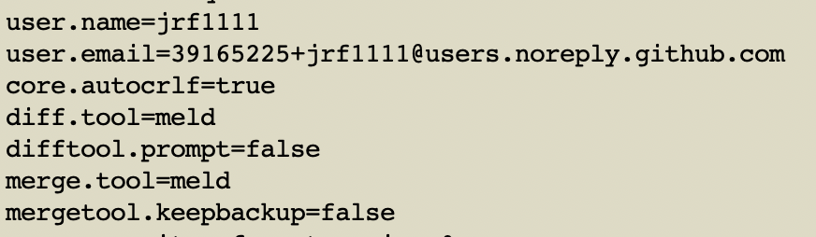
Installing and configuring Git
Confirm configuration settings: $git config --list
Office of Institutional Research

Slide 21
Setting up a Project with Git(Hub)
Office of Institutional Research

Slide 22
Setting up a repo
GitHub >> New repo >> readme and permissions >> copy URL
$cd <path/to/directory/for/repo>
$git clone <URL>
Office of Institutional Research

Slide 23
Using Your First Repo
Office of Institutional Research

Slide 24
Local Computer
Version Database
V2: commit ID e7254b9ad
Author: JakeRF
Date: 14:30:00 Aug. 4, 2020
Add headcounts
GitHub
git push
Version Database
V1: commit ID 50eace74bt
Author: JakeRF
Date: 09:21:57 Aug. 3, 2020
Create DRS 3456 repo
V2: commit ID e7254b9ad
Author: JakeRF
Date: 14:30:00 Aug. 4, 2020
Add headcounts
git pull
V1: commit ID 50eace74bt
Author: JakeRF
Date: 09:21:57 Aug. 3, 2020
Create DRS 3456 repo
git commit
Working Copy
Staging Area
git add
Office of Institutional Research

Slide 25
Using your repo
See where things stand: $git status
See what’s happened: $git log
Add file to staging area: $git add <file>
Add all files to staging area: $git add -A or $git add --all
Commit changes: $git commit -m ‘useful message’
Get changes from GH: $git pull
Send changes to GH: $git push
Office of Institutional Research

Slide 26
Using your repo
See what’s changed since last commit: $git difftool
See what’s changed since a specific commit: $git difftool <commit ID>
Compare two commits: $git difftool <old commit ID> <new commit ID>
Compare GH vs. local files: $git difftool origin/master
Office of Institutional Research

Slide 27
Undoing/Reverting/ Resetting Changes
Office of Institutional Research

Slide 28
Undoing uncommitted changes
$git checkout -- <path/to/file>
Works where undo won’t/can’t
$git checkout -- .
Undo ALL changes in the directory since last commit
Office of Institutional Research

Slide 29
Undoing committed changes
$git revert <commit ID>
Use the commit ID of the commit you want to undo, not the one you want to go back to
Office of Institutional Research

Slide 30
Going back to an old commit
$git reset --soft <commit ID>
Uncommit changes but leave them staged
Use if a commit is incomplete or typo in commit message
$git reset --mixed <commit ID>
Uncommit and unstage changes
Use if a file was added that shouldn’t have been added
Office of Institutional Research

Slide 31
Going back to an old commit
$git reset --hard <commit ID>
Uncommit, unstage, and DELETE changes
WARNING: this will delete all the commits between your current commit and the one you reset back to
WARNING: this will delete all local files that were not in the commit you reset back to
Use as a last resort if things have gone horribly wrong
Office of Institutional Research

Slide 32
Branching Out
Office of Institutional Research

Slide 33
Title
Text
Bullet list
Office of Institutional Research

Slide 34
Title
Text
Bullet list
Office of Institutional Research

Slide 35
Title
Text
Bullet list
Office of Institutional Research

Slide 36
Title
Text
Bullet list
Office of Institutional Research

Slide 37
Title
Text
Bullet list
Office of Institutional Research

